Slide 1
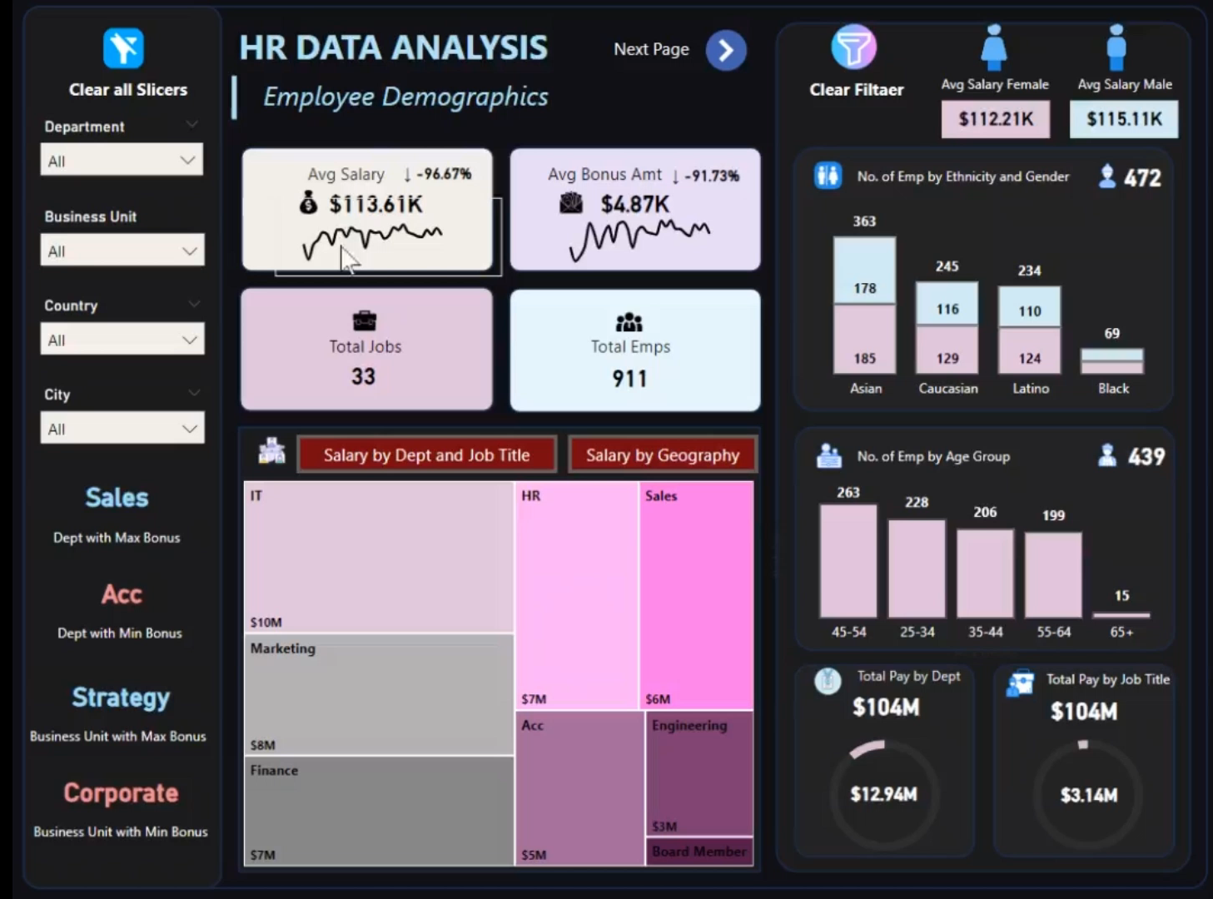

Slide 2
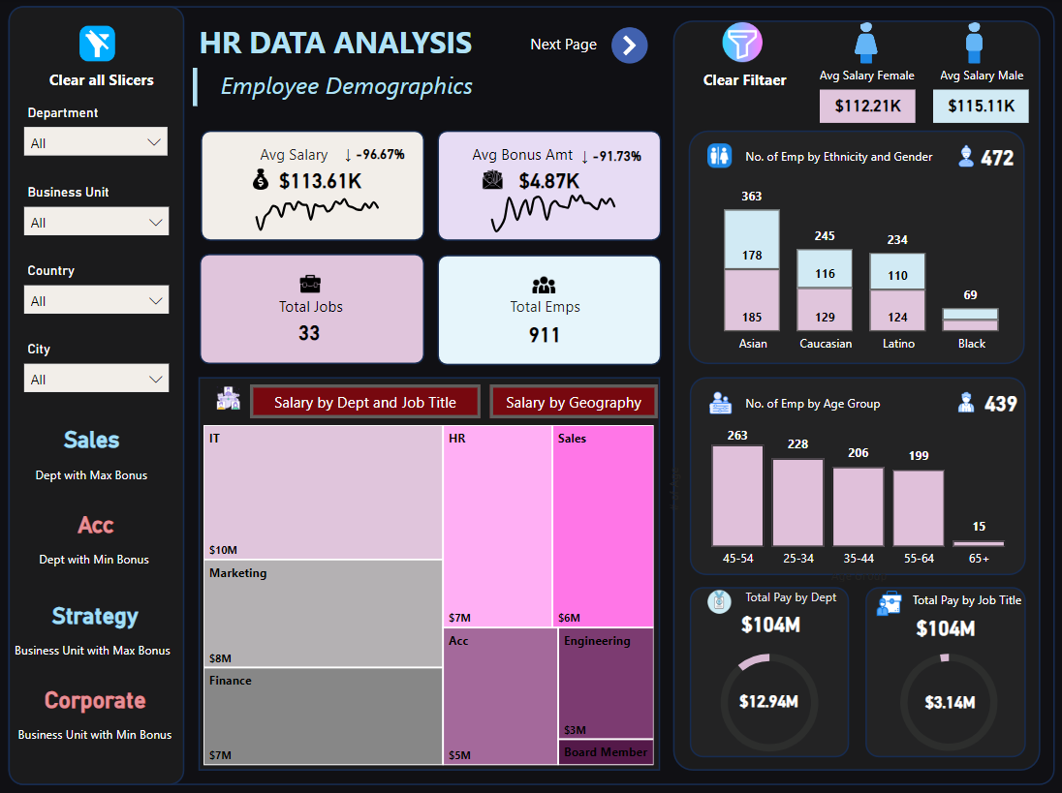

Slide 3
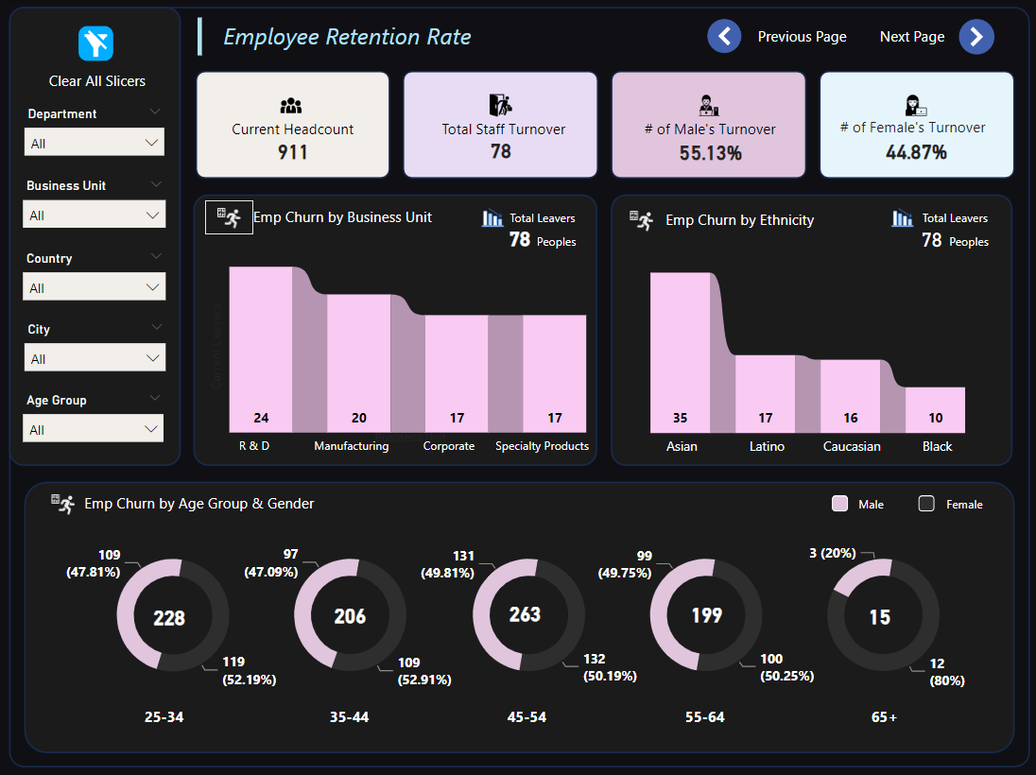

Slide 4
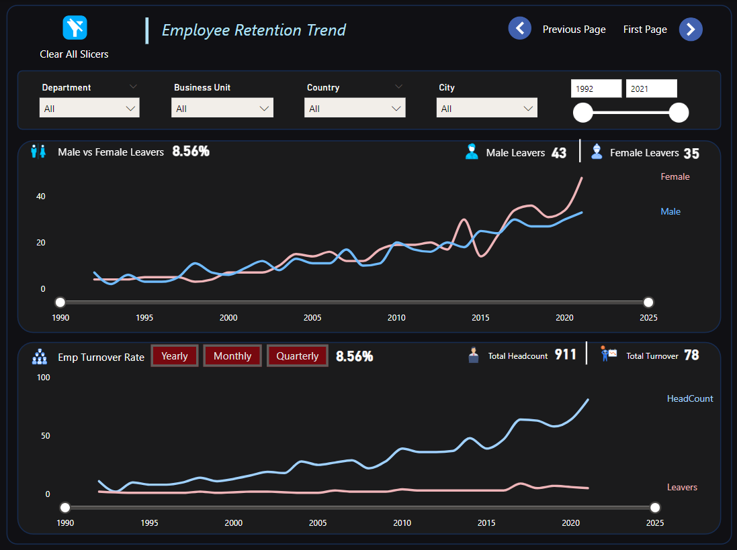

Slide 5
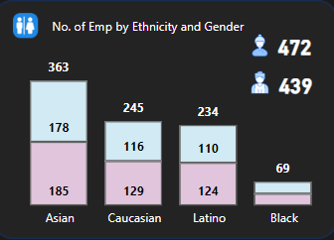
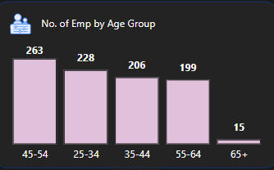
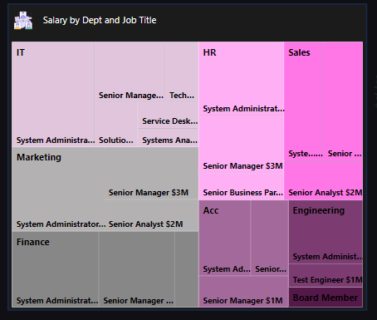
HR Data Analytics Insights
1. How diverse is the workforce regarding gender, ethnicity, and age?
The current workforce comprises a total of 911 employees, with 472 identified as female and 439 as male.
When considering ethnic diversity, it's notable that individuals identifying as Black represent the smallest proportion at 7.57% of the total workforce, indicating an area where efforts to enhance representation and inclusion could be focused.
2. Is there a correlation between pay levels, departments, and job titles?
There's a clear correlation between pay levels, departments, and job titles.
System Administrators consistently earn the most across departments.
The IT department boasts the highest salaries, followed by Marketing and HR. (For ex, System Administrator earns $4.4M in the IT Dept, $4M in the Marketing Dept, and $3.4M in Finance)
Interestingly, Board Members and Engineers earn less than management-related roles, highlighting a potential compensation discrepancy.

Slide 6
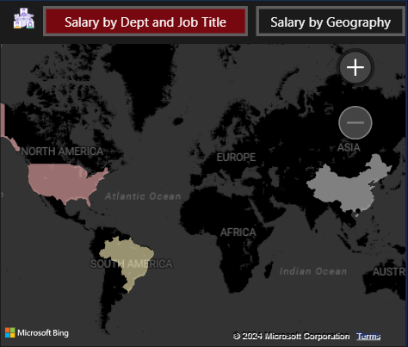
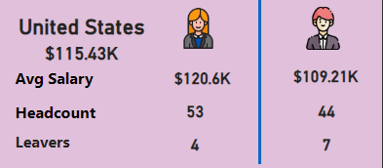
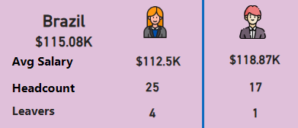
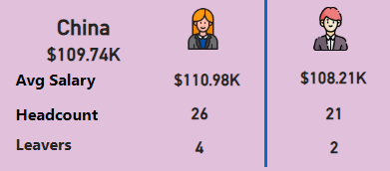
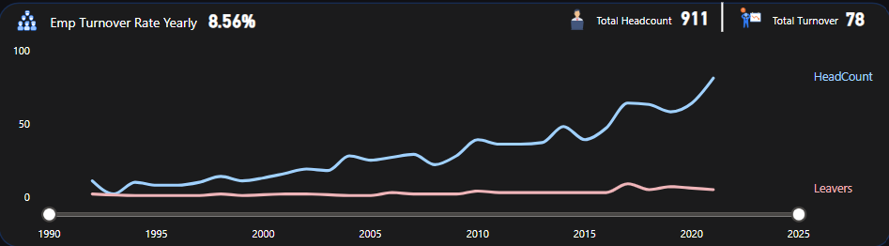
HR Data Analytics Insights
3. How about the geographic distribution of the workforce?
United States: In the United States, 97 employees are comprising the workforce, with an average salary of $115.43K.
Brazil: Brazil has a workforce of 42 employees, and the average salary among them is $115.08K.
China: Within China, 47 employees are forming the workforce, with an average salary of $109.74K.
4. What is the employee retention rate trend yearly?
The employee retention rate remains consistent annually.
Total headcount stands at 911 employees.
A constant count of 78 employees leaves the company each year.
This results in a turnover ratio of 8.56%.
Despite a linear increase in overall headcount, the number of employees leaving remains constant.

Slide 7
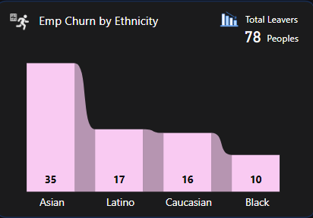
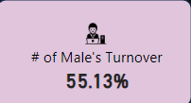
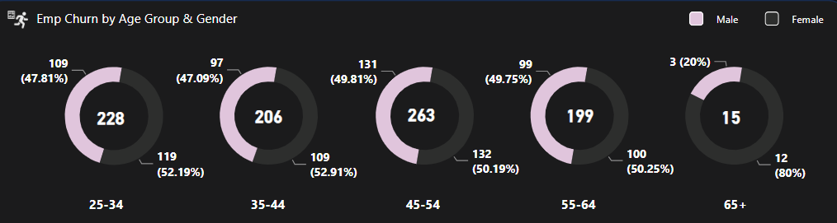
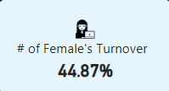
HR Data Analytics Insights
5. What is the employee retention rate regarding gender, ethnicity, and age?
Gender:
Male turnover ratio: 53.13%
Female turnover ratio: 44.87%
Age:
Employees aged between 25-55 have a 50-50% turnover ratio.
After age 55, the gender distribution shifts significantly, with approximately 80% of employees being female and 20% being male.
Ethnicity:
Asian employees, being the most numerous, have the highest turnover rate.
Black employees, with fewer numbers, exhibit a lower turnover rate.

Slide 8
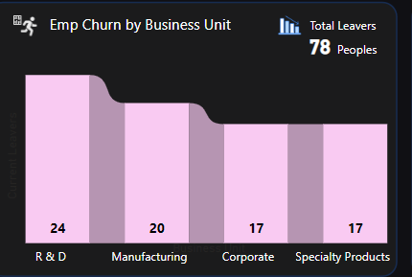

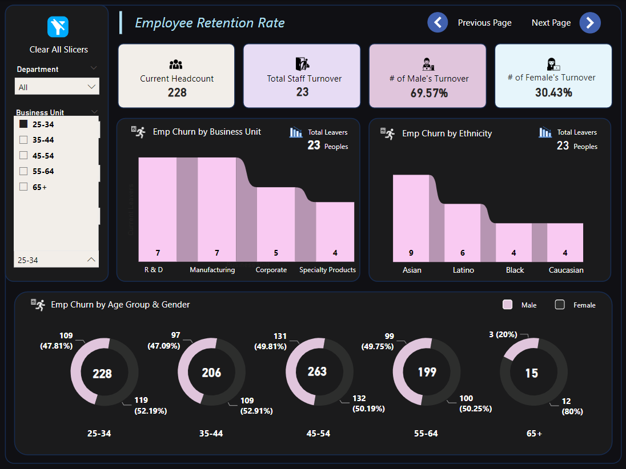
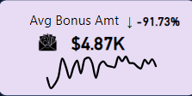
HR Data Analytics Insights
6. Which business unit had the highest and lowest employee retention rate?
Total Retention rate is 78.
Highest Employee Retention Rate: R & D
Retention Rate: 24 employees
Lowest Employee Retention Rate: Specially Products
Retention Rate: 17 employees
7. Which business unit and department paid the most and least bonuses annually?
8. What is the annual historical bonuas trend? Can we show new hires some statistics?

Slide 9
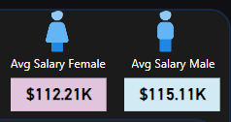
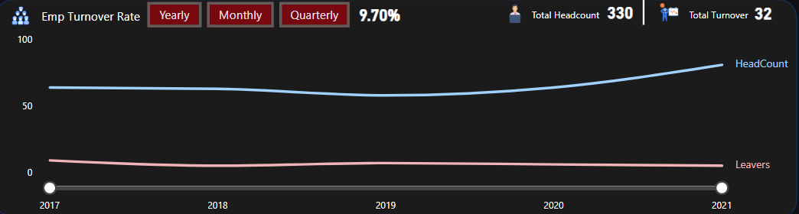
HR Data Analytics Insights
9. How about the pay equity based on gender, ethnicity, and age?
Gender Pay Equity:
Male Employees: 439
- Average Salary: $115.11K
Female Employees: 472
- Average Salary: $112.21K
Ethnicity Diversity:
Both men and women show similar diversity based on ethnicity.
There are more Asian employees compared to other ethnicities.
There is a lower representation of Black employees in the company.
10. What is the employee turnover rate (eg, monthly, quarterly, annually) since 2017?
The Retention rate after 2017 is:
Yearly - 9.28%
Monthly - 9.70%
Quarterly - 9.70%

